Slide 1
Data Mining
Data Preprocessing (Ch # 3)

Slide 2
Data Preprocessing
Why preprocess the data?
Data cleaning
Data integration
Data reduction
Data Transformation and Discretization
Summary

Slide 3
Why Data Preprocessing?
Data in the real world is dirty
incomplete: lacking attribute values, lacking certain attributes of interest, or containing only aggregate data
noisy: containing errors or outliers
inconsistent: containing discrepancies in codes or names
Data quality is a major concern in Data Mining and Knowledge Discovery tasks.
Why: At most all Data Mining algorithms induce knowledge strictly from data.
No quality data, no quality mining results!
Quality decisions must be based on quality data
No quality data, inefficient mining process!
Complete, noise-free, and consistent data means faster algorithms
The quality of knowledge extracted highly depends on the quality of data

Slide 4
Major Tasks in Data Preprocessing
Data cleaning
Fill in missing values, smooth noisy data, identify or remove outliers, and resolve inconsistencies
Data integration
Integration of multiple databases, data cubes, or files
Data reduction
Obtains reduced representation in volume but produces the same or similar analytical results
Data transformation
Normalization and aggregation
Data discretization
Part of data reduction but with particular importance, especially for numerical data

Slide 5
Data Preprocessing
Why preprocess the data?
Data cleaning
Data integration
Data reduction
Data Transformation and Discretization
Summary

Slide 6
Data Cleaning
Data in the Real World Is Dirty: Lots of potentially incorrect data, e.g., instrument faulty, human or computer error, transmission error
incomplete: lacking attribute values, lacking certain attributes of interest, or containing only aggregate data
e.g., Occupation=“ ” (missing data)
noisy: containing noise, errors, or outliers
e.g., Salary=“−10” (an error)
inconsistent: containing discrepancies in codes or names, e.g.,
Age=“42”, Birthday=“03/07/2010”
Was rating “1, 2, 3”, now rating “A, B, C”
discrepancy between duplicate records
Intentional (e.g., disguised missing data)
Jan. 1 as everyone’s birthday?

Slide 7
Data Cleaning
Data cleaning tasks
Fill in missing values
Noisy data
Correcting inconsistent data

Slide 8
Methods of Treating Missing Data
Ignoring and discarding data:- There are two main ways to discard data with missing values.
Discard all those records which have missing data also called as discard case analysis. Usually done when class label is missing (assuming the task is classification)
Discarding only those attributes which have high level of missing data.
Fill in the missing value manually: tedious + infeasible?
Use a global constant to fill in the missing value: e.g., “unknown”, a new class.
Imputation using Mean/median or Mod:- One of the most frequently used method (Statistical technique).
Use the attribute mean to fill in the missing value
Use the attribute mean for all samples belonging to the same class to fill in the missing value: smarter
Replace (numeric continuous) type “attribute missing values” using mean/median. (Median robust against noise).
Replace (discrete) type attribute missing values using MOD.

Slide 9
Methods of Treating Missing Data
K-Nearest Neighbor (k-NN) approach (Best approach):-
k-NN imputes the missing attribute values on the basis of nearest K neighbor. Neighbors are determined on the basis of distance measure.
Once K neighbors are determined, missing value are imputed by taking mean/median or MOD of known attribute values of missing attribute.
Missing value record
Other dataset records

Slide 10
Imputation of Missing Data (Basic)
Imputation is a term that denotes a procedure that replaces the missing values in a dataset by some plausible values
i.e. by considering relationship among correlated values among the attributes of the dataset.
If we consider only {attribute#2}, then value “cool” appears in 3 records.
Probability of Imputing value (20) = 66.7%
Probability of Imputing value (30) = 33.3%

Slide 11
Imputation of Missing Data (Basic)
For {attribute#4} the value “true” appears in 2 records
Probability of Imputing value (20) = 50%
Probability of Imputing value (10) = 50%
For {attribute#2, attribute#3} the value {“cool”, “high”} appears in only 2 records
Probability of Imputing value (20) = 100%

Slide 12
Detecting Outliers (Clustering)
Outliers may be detected by clustering, where similar values are organized into groups or “clusters”.
Values which falls outside of the set of clusters may be considered outliers.

Slide 13
Data Preprocessing
Why preprocess the data?
Data cleaning
Data integration
Data reduction
Data Transformation and Discretization
Summary
13

Slide 14
Data Integration
Data integration:
combines data from multiple sources into a coherent store
Entity Identification Problem:
How can we match schema and objects from different sources
How can equivalent real world entities from multiple data sources be matched up?
14

Slide 15
Data Integration (Problem 1)
Attribute naming ( in schema integration) Problem: Entity identification problem: identify real world entities from multiple data sources. Attributes are named differently across different data sources, e.g., A.cust-id ≡ B.cust-# (integrate metadata from different sources).
CustomerID
…
…
CustomerID
CustID
…
…
…
…
Extraction, Transformation, and Loading (ETL) tool.
ClientID
…
…
Multiple Sources
Coherent Store
15

Slide 16
Data Integration (Problem 2)
Data Encoding Problem: Same attribute has same values denoted in different ways
Gender
Male
Female
Gender
Gender
Male
M
Female
F
Multiple Sources
Coherent Store
Similarly, Islamabad might be denoted as ‘isb’, ‘ISB’ or ‘ISBD’, may be misspelled, or be inconsistently capitalized (some programs are CASE-SENSITIVE)
16

Slide 17
Data Integration (Problem 3)
Measurement Basis (data value conflicts) Problem: For the same real world entity, attribute values from different sources are different
possible reasons: different representations, different scales, e.g., metric vs. British units, kg vs lb
Weight (kilograms)
6
Weight (kilograms)
10
Weight (pounds)
6
10
2.72
6
4.54
10
Multiple Sources
Coherent Store
17

Slide 18
Handling Redundant Data in Data Integration
Redundant data occur often when integrating multiple databases
The same attribute may have different names in different databases
One attribute may be a “derived” attribute in another table, e.g., annual revenue
Careful integration of the data from multiple sources may help reduce/avoid redundancies and inconsistencies and improve mining speed and quality
Redundancy can be checked using correlation Analysis.
18

Slide 19
Correlation Analysis for Detecting Redundancy
For numeric attributes we can use correlation and covariance
Correlation between two attributes can be checked by:-
Resulting value > 0, then A and B are positively correlated. If A increase B will also increase. If value of r is close to 1 either A or B can be removed
Resulting value = 0, then A and B are independent.
Resulting value < 0, then A and B are negatively correlated. If the value of A increases, the value B will decreases.
Covariance between two attributes is
Under some assumptions a covariance of 0 implies independence
19

Slide 20
Example: Correlation and Covariance
For the following data find correlation and covariance measures value
Time point | AllElctronics (A) | HighTech (B)
t1 | 6 | 20
t2 | 5 | 10
t3 | 4 | 14
t4 | 3 | 5
t5 | 2 | 5
Total | 20 | 54
20

Slide 21
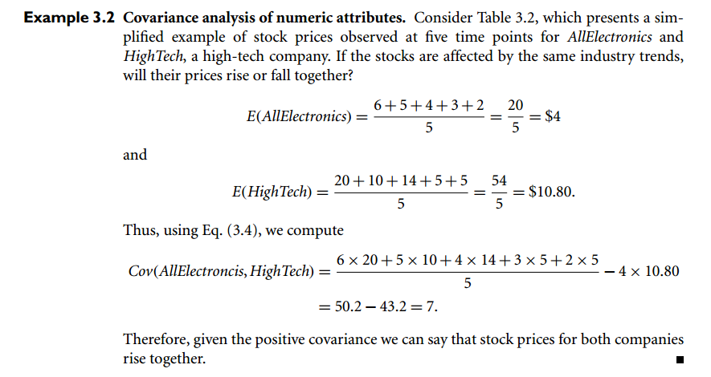

Slide 22
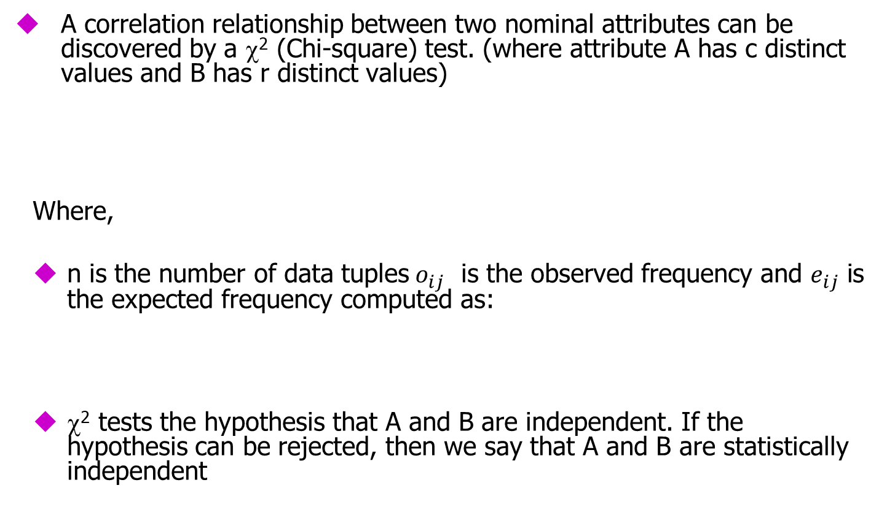
χ² Correlation Test for Nominal Data
22

Slide 23
Example: For the following data find weather the two attributes are independent or not. Suppose that we have 1500 data points
 | male | female | Total
Fiction | 250 | 200 | 450
Non-fiction | 50 | 1000 | 1050
Total | 300 | 1200 | 1500

Slide 24
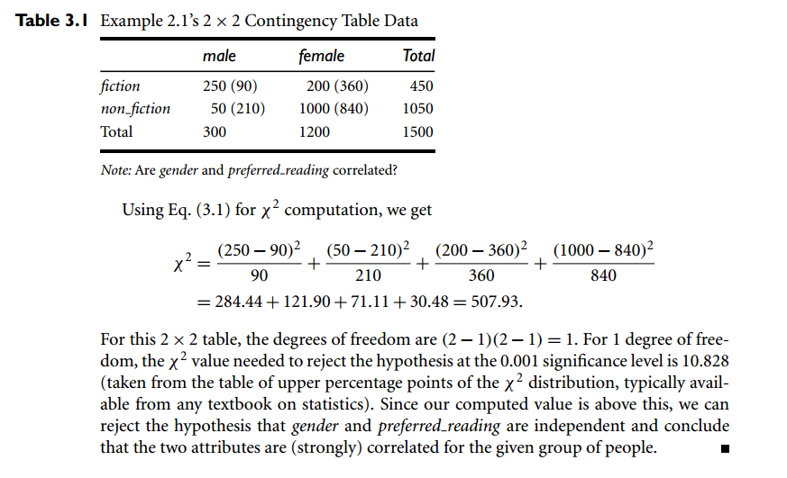

Slide 25
Data Preprocessing
Why preprocess the data?
Data cleaning
Data integration
Data reduction
Data Transformation and Discretization
Summary
25

Slide 26
Data Transformation
The data are transformed or consolidated into forms appropriate for mining processing. Different strategies includes
Normalization – data are scaled so as to fall within a smaller rage e.g. -1.0 to 1.0 or 0.0 to 1.0
Discretization - Values of numeric attribute are replaced by interval labels or conceptual labels. (concept hierarchy for numeric attribute)
Concept hierarchy generation for nominal data – nominal attribute values are generalized to higher-level concepts e.g. street is generalized to block, city or country.
26

Slide 27
Data Normalization
min-max normalization
Example:- Suppose that the minimum and maximum values for the attribute income are 12,000 and 98,000. By min-max normalization, a value of 73,600 for income is transformed to
((73,000-12,000)/(98,000-12,000)) (1.0-0) + 0 = 0.716

Slide 28
Data Normalization
z-score normalization
This method of normalization is useful when the actual minimum and maximum of any attribute are unknown.
Or when outliers which dominate the min-max normalization.
Decimal scaling normalization
Where j is the smallest integer such that Max(| |)<1

Slide 29
Building mineable data sets Data Transformation: Normalization
min-max normalization
z-score normalization
normalization by decimal scaling
Where j is the smallest integer such that Max(| |)<1
Price in €
4
6
14
16
18
19
21
22
23
24
27
34
Min-max [0,1]
0
.06
.33
.4
.46
.5
.56
.6
.63
.66
.76
1
Z-score
-1.8
-1.6
-0.6
-0.3
-0.1
0
0.2
0.4
0.5
0.6
1
1.8
decimal
.04
.06
.14
.16
.18
.19
.21
.22
.23
.24
.27
.34

Slide 30
Concept Hierarchy Generation
Concept hierarchy organizes concepts (i.e., attribute values) hierarchically and is usually associated with each dimension in a data warehouse
Concept hierarchies facilitate drilling and rolling in data warehouses to view data in multiple granularity
Concept hierarchy formation: Recursively reduce the data by collecting and replacing low level concepts (such as numeric values for age) by higher level concepts (such as youth, adult, or senior)
Concept hierarchies can be explicitly specified by domain experts and/or data warehouse designers
Concept hierarchy can be automatically formed for both numeric and nominal data. For numeric data, use discretization methods shown.

Slide 31
Automatic Concept Hierarchy Generation
Some hierarchies can be automatically generated based on the analysis of the number of distinct values per attribute in the data set
The attribute with the most distinct values is placed at the lowest level of the hierarchy
Exceptions, e.g., weekday, month, quarter, year
country
15 distinct values
province_or_ state
365 distinct values
city
3567 distinct values
street
674,339 distinct values

